Slide 1
Bag Implementations that Use Arrays
Chapter 2
Data Structures and Abstractions with Java, 4e
Frank Carrano
© 2015 Pearson Education, Inc., Upper Saddle River, NJ. All rights reserved.

Slide 2
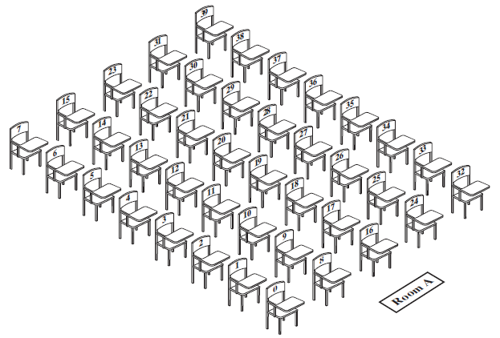
Fixed-Size Array to
Implement the ADT Bag
FIGURE 2-1 A classroom that contains
desks in fixed positions
© 2015 Pearson Education, Inc., Upper Saddle River, NJ. All rights reserved.

Slide 3
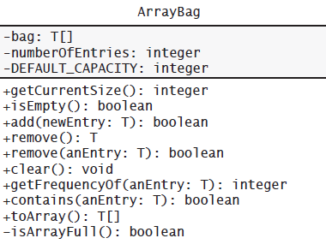
Fixed-Size Array
FIGURE 2-2 UML notation for the class ArrayBag, including the class’s data fields
© 2015 Pearson Education, Inc., Upper Saddle River, NJ. All rights reserved.

Slide 4
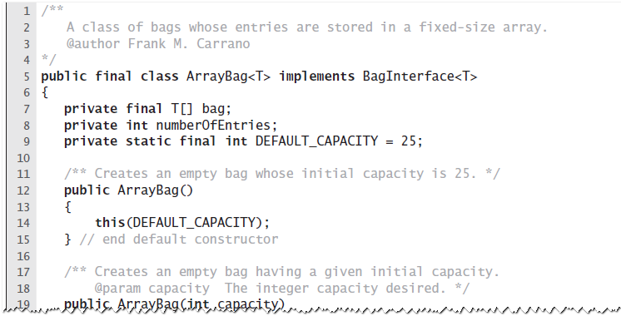
Fixed-Size Array
LISTING 2-1 An outline of the class ArrayBag
© 2015 Pearson Education, Inc., Upper Saddle River, NJ. All rights reserved.

Slide 5
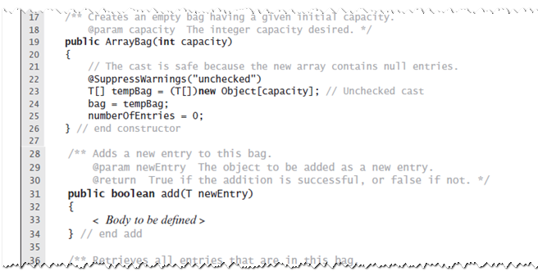
Fixed-Size Array
LISTING 2-1 An outline of the class ArrayBag
© 2015 Pearson Education, Inc., Upper Saddle River, NJ. All rights reserved.

Slide 6
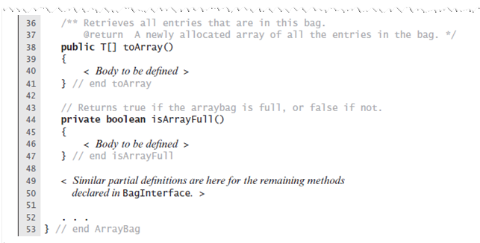
Fixed-Size Array
LISTING 2-1 An outline of the class ArrayBag
© 2015 Pearson Education, Inc., Upper Saddle River, NJ. All rights reserved.

Slide 7
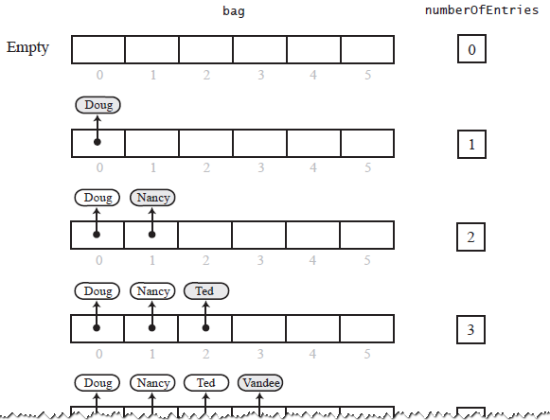
Fixed-Size Array
FIGURE 2-3 Adding entries to an array that represents a bag, whose capacity is six, until it becomes full
© 2015 Pearson Education, Inc., Upper Saddle River, NJ. All rights reserved.

Slide 8
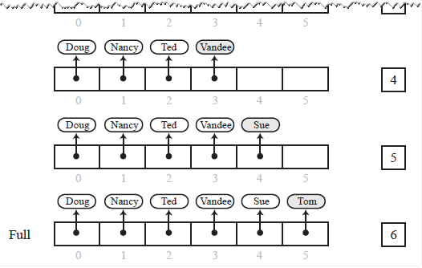
Fixed-Size Array
FIGURE 2-3 Adding entries to an array that represents a bag, whose capacity is six, until it becomes full
© 2015 Pearson Education, Inc., Upper Saddle River, NJ. All rights reserved.

Slide 9
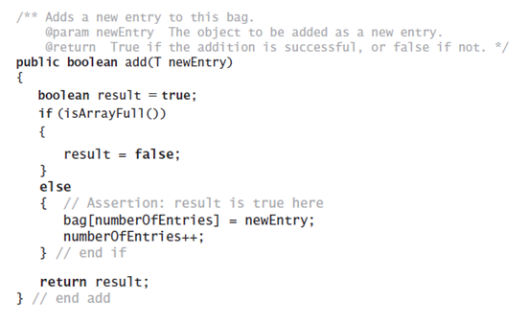
Fixed-Size Array
Method add
© 2015 Pearson Education, Inc., Upper Saddle River, NJ. All rights reserved.

Slide 10
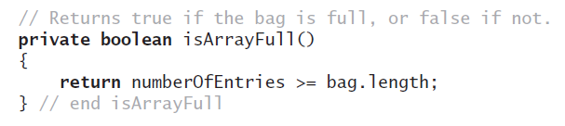
Fixed-Size Array
Method isFull
© 2015 Pearson Education, Inc., Upper Saddle River, NJ. All rights reserved.

Slide 11
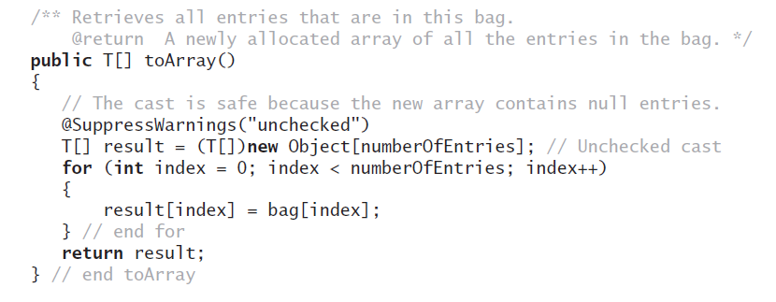
Fixed-Size Array
Method toArray
© 2015 Pearson Education, Inc., Upper Saddle River, NJ. All rights reserved.

Slide 12

Making the Implementation Secure
Practice fail-safe programming by including checks for anticipated errors
Validate input data and arguments to a method
refine incomplete implementation of ArrayBag to make code more secure by adding the following two data fields
© 2015 Pearson Education, Inc., Upper Saddle River, NJ. All rights reserved.

Slide 13
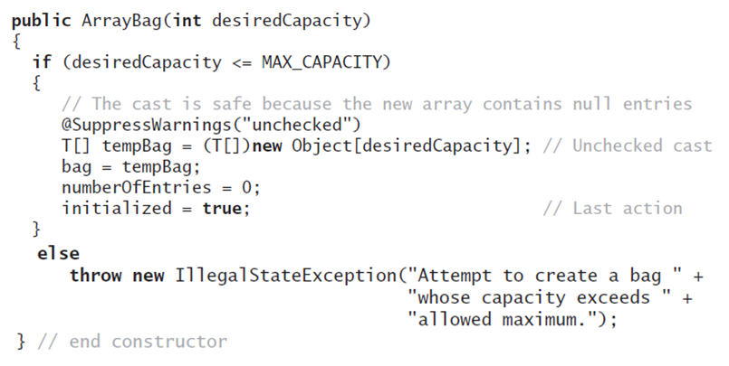
Making the Implementation Secure
Revised constructor
© 2015 Pearson Education, Inc., Upper Saddle River, NJ. All rights reserved.

Slide 14
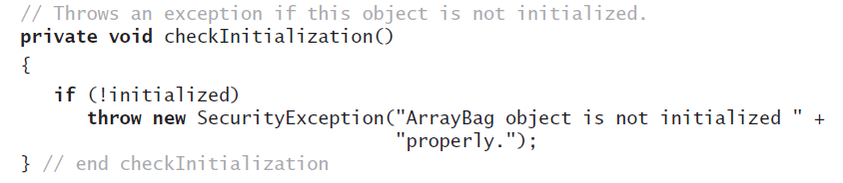
Making the Implementation Secure
Method to check initialization
© 2015 Pearson Education, Inc., Upper Saddle River, NJ. All rights reserved.

Slide 15
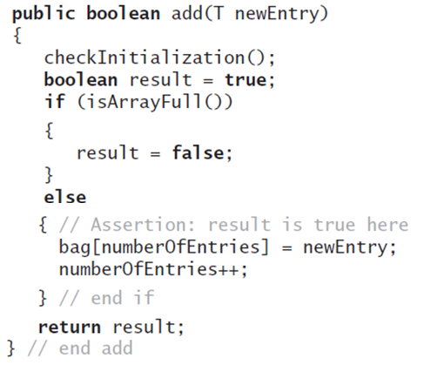
Making the Implementation Secure
Revise the method add
© 2015 Pearson Education, Inc., Upper Saddle River, NJ. All rights reserved.

Slide 16
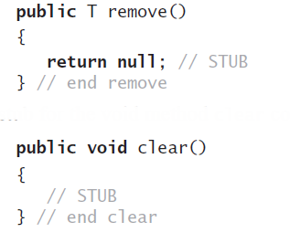
Testing the Core Methods
Stubs for remove and clear
© 2015 Pearson Education, Inc., Upper Saddle River, NJ. All rights reserved.

Slide 17
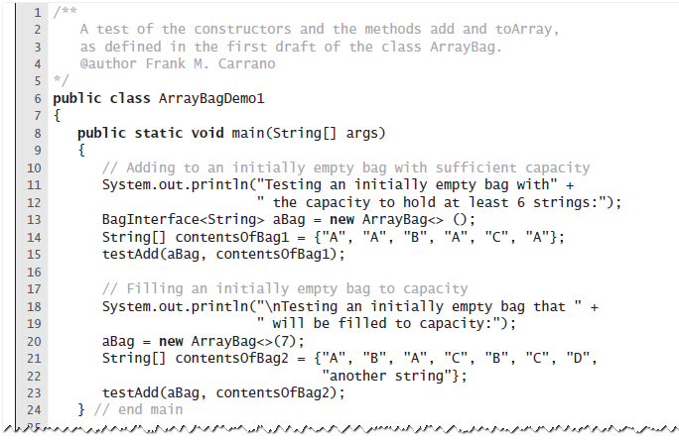
Testing the Core Methods
LISTING 2-2 A program that tests core methods
of the class ArrayBag
© 2015 Pearson Education, Inc., Upper Saddle River, NJ. All rights reserved.

Slide 18
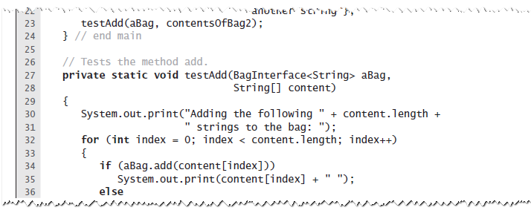
Testing the Core Methods
LISTING 2-2 A program that tests core methods
of the class ArrayBag
© 2015 Pearson Education, Inc., Upper Saddle River, NJ. All rights reserved.

Slide 19
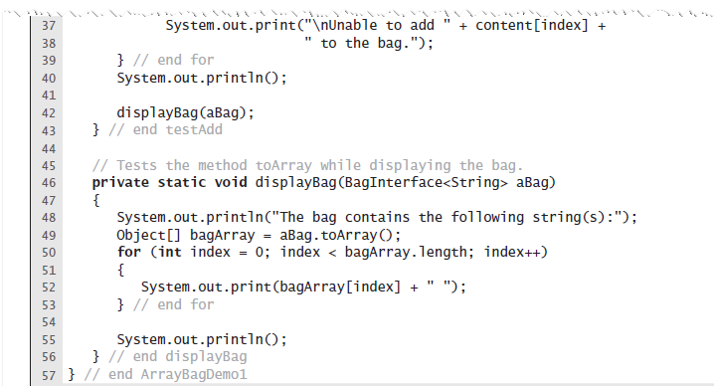
Testing the Core Methods
LISTING 2-2 A program that tests core methods
of the class ArrayBag
© 2015 Pearson Education, Inc., Upper Saddle River, NJ. All rights reserved.

Slide 20
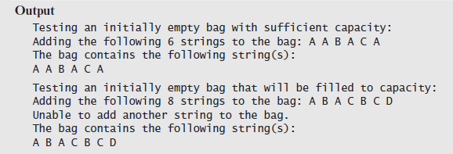
Testing the Core Methods
LISTING 2-2 A program that tests core methods
of the class ArrayBag
© 2015 Pearson Education, Inc., Upper Saddle River, NJ. All rights reserved.

Slide 21
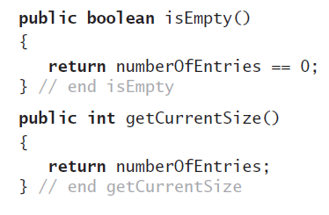
Implementing More Methods
Methods isEmpty and getCurrentSize
© 2015 Pearson Education, Inc., Upper Saddle River, NJ. All rights reserved.

Slide 22
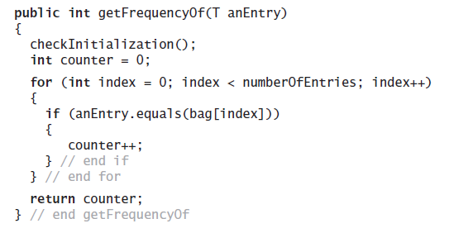
Implementing More Methods
Method getFrequencyOf
© 2015 Pearson Education, Inc., Upper Saddle River, NJ. All rights reserved.

Slide 23
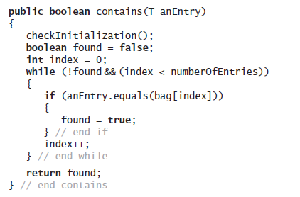
Implementing More Methods
Method contains
© 2015 Pearson Education, Inc., Upper Saddle River, NJ. All rights reserved.

Slide 24
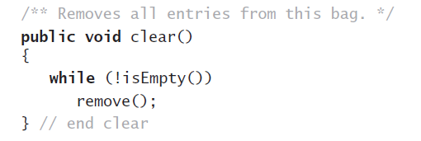
Methods That Remove Entries
The method clear
© 2015 Pearson Education, Inc., Upper Saddle River, NJ. All rights reserved.

Slide 25
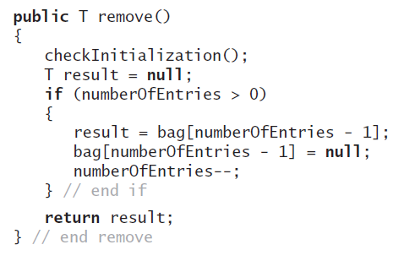
Methods That Remove Entries
The method remove
© 2015 Pearson Education, Inc., Upper Saddle River, NJ. All rights reserved.

Slide 26
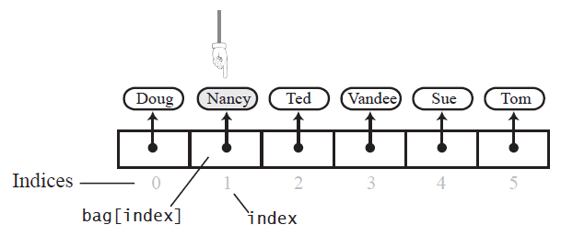
Methods That Remove Entries
FIGURE 2-4 The array bag after a successful
search for the string “Nancy"
© 2015 Pearson Education, Inc., Upper Saddle River, NJ. All rights reserved.

Slide 27
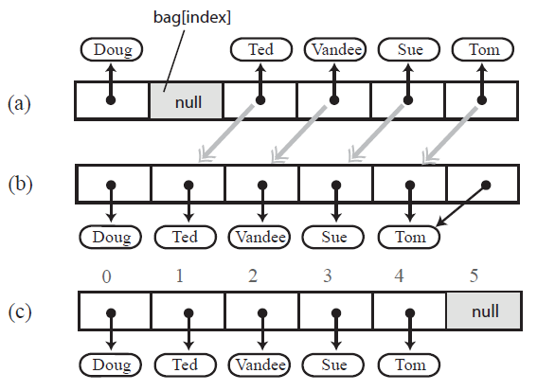
Methods That Remove Entries
FIGURE 2-5 (a) A gap in the array bag after setting the entry in bag[index] to null; (b) the array after shifting subsequent entries to avoid a gap
© 2015 Pearson Education, Inc., Upper Saddle River, NJ. All rights reserved.

Slide 28
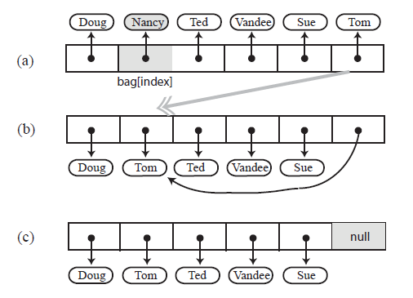
Methods That Remove Entries
FIGURE 2-6 Avoiding a gap in the array
while removing an entry
© 2015 Pearson Education, Inc., Upper Saddle River, NJ. All rights reserved.

Slide 29
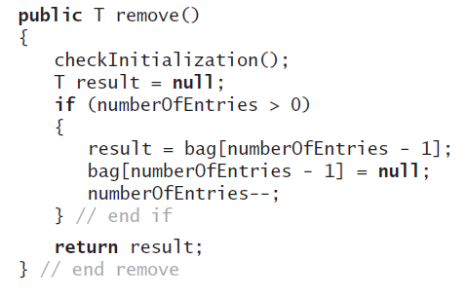
Methods That Remove Entries
New definition of remove
© 2015 Pearson Education, Inc., Upper Saddle River, NJ. All rights reserved.

Slide 30
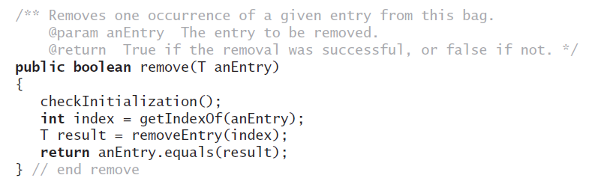
Methods That Remove Entries
The second remove method
© 2015 Pearson Education, Inc., Upper Saddle River, NJ. All rights reserved.

Slide 31
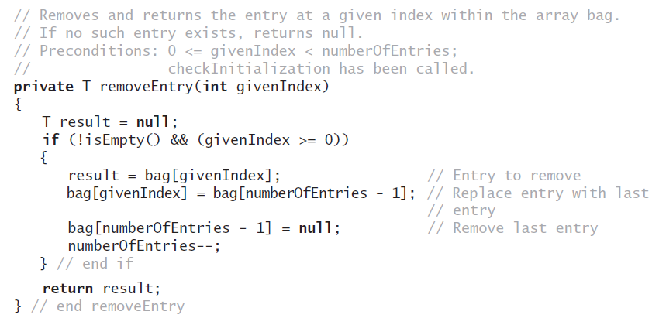
Methods That Remove Entries
The removeEntry method
© 2015 Pearson Education, Inc., Upper Saddle River, NJ. All rights reserved.

Slide 32
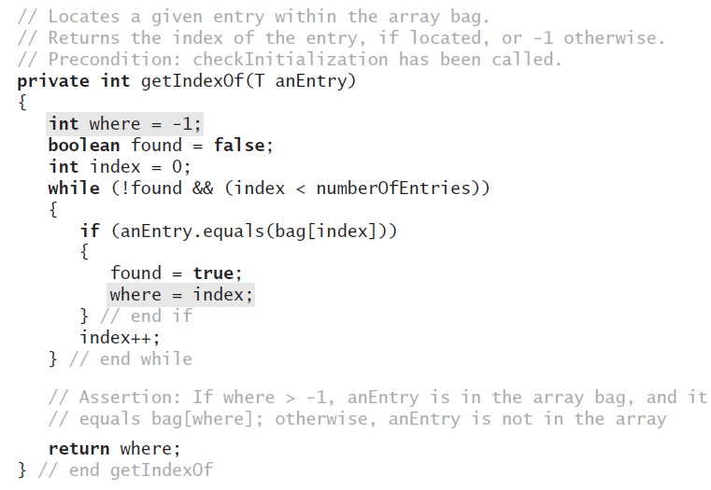
Methods That Remove Entries
Definition for the method getIndexOf
© 2015 Pearson Education, Inc., Upper Saddle River, NJ. All rights reserved.

Slide 33
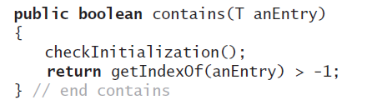
Methods That Remove Entries
Revised definition for the method contains
© 2015 Pearson Education, Inc., Upper Saddle River, NJ. All rights reserved.

Slide 34
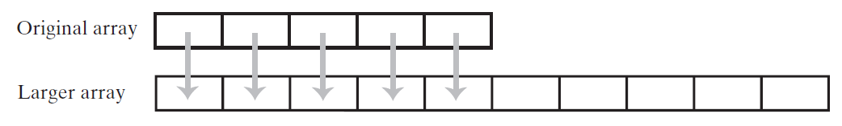
Using Array Resizing
FIGURE 2-7 Resizing an array copies its
contents to a larger second array
© 2015 Pearson Education, Inc., Upper Saddle River, NJ. All rights reserved.

Slide 35
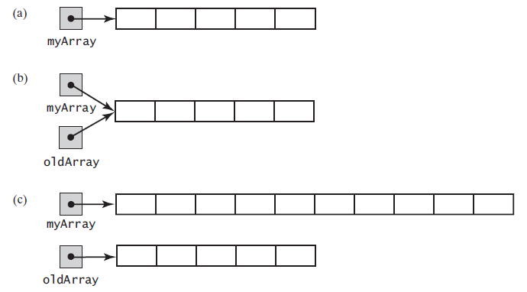
Using Array Resizing
FIGURE 2-8 (a) An array; (b) two references to the same array; (c) the original array variable now references a new, larger array;
© 2015 Pearson Education, Inc., Upper Saddle River, NJ. All rights reserved.

Slide 36
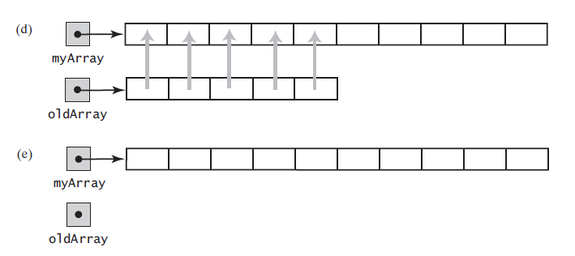
Using Array Resizing
FIGURE 2-8 (d) the entries in the original array are copied to the new array; (e) the original array is discarded
© 2015 Pearson Education, Inc., Upper Saddle River, NJ. All rights reserved.

Slide 37
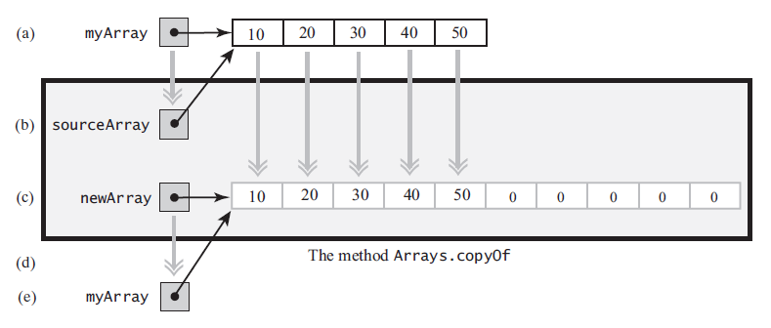
Using Array Resizing
FIGURE 2-9 The effect of the statement
myArray = Arrays.copyOf(myArray, 2 * myArray.length);
(a) The argument array; (b) the parameter that references the argument array; (c) a new, larger array that gets the contents of the argument array; (d) the return value that references the new array; (e) the argument variable is assigned the return value
© 2015 Pearson Education, Inc., Upper Sa ddle River, NJ. All rights reserved.

Slide 38
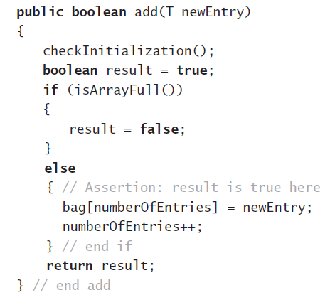
New Implementation of a Bag
Previous definition of method add
© 2015 Pearson Education, Inc., Upper Saddle River, NJ. All rights reserved.

Slide 39
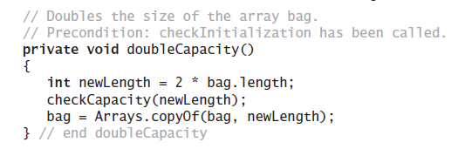
New Implementation of a Bag
Revision of method doubleCapacity
© 2015 Pearson Education, Inc., Upper Saddle River, NJ. All rights reserved.

Slide 40
Pros and Cons of
Using an Array
Adding an entry to the bag is fast
Removing an unspecified entry is fast
Removing a particular entry requires time to locate the entry
Increasing the size of the array requires time to copy its entries
© 2015 Pearson Education, Inc., Upper Saddle River, NJ. All rights reserved.

Slide 41
End
Chapter 2
© 2015 Pearson Education, Inc., Upper Saddle River, NJ. All rights reserved.

